Slide 1


Face recognition attendance system
Assoc. Prof. : Ahmed ElMahalawy

Slide 2

Introduction
Our project
01
03
Previous work
02
Contain:
Discussing the main idea of the project.
Discussing what we do till now in our project
Previous implementation of the idea

Slide 3

introduction
COVID-19 is an infectious disease caused by the recently found virus known as coronavirus. in Wuhan, China on December 2019, there was no information about this virus, ever since that the world is suffering to have our normal life back with limited contact to reduce the infection.

Slide 4
introduction
So, our main idea to replace traditional fingerprint attendance systems with a new one using face recognition technology.

Slide 5
introduction
Facial recognition is a way of identifying or confirming an individual’s identity using their face. Facial recognition systems can be used to identify people in photos, videos, or in real-time.

Slide 6
EVOLUTION OF ATTENDANCE SYSTEMS
Manual handwritten journal
Paper timesheets
Traditional punch clock
Biometric attendance systems
Face attendance system

Slide 7
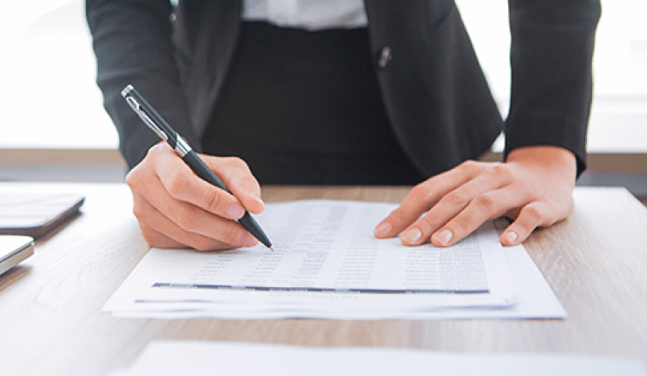
EVOLUTION OF ATTENDANCE SYSTEMS:
Manual handwritten journal: surprisingly, some companies still use this method to track employee attendance. Yet most modern companies don’t use it anymore because it’s inconvenient and requires to have a responsible person for filling it in.

Slide 8
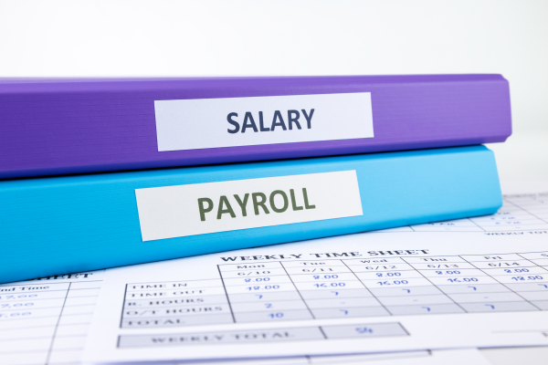
EVOLUTION OF ATTENDANCE SYSTEMS:
Paper timesheets: it’s already a thing of a past. extremely inefficient now. because employees have to constantly keep track of what they do, and if they don`t – they have to come up with something. So there’s a place for fraud here. Secondly, the procession of paper time sheets takes a lot of time.

Slide 9
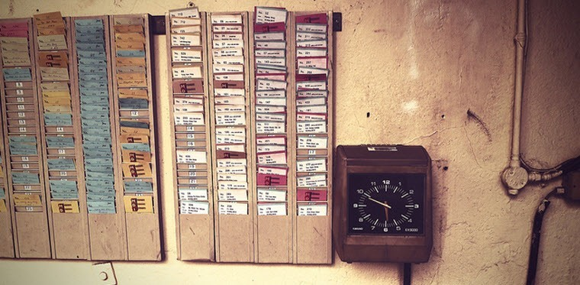
Traditional punch clock : it’s a mechanical or electronic device used to track employee attendance. Traditionally the data was recorded on paper punch cards which were physically stamped or punched by the clock. Paper punch cards are still used at some workplaces even today.
EVOLUTION OF ATTENDANCE SYSTEMS:

Slide 10
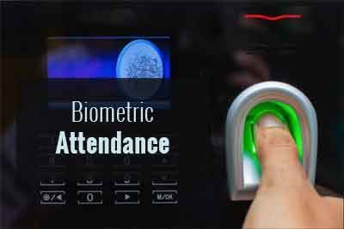
EVOLUTION OF ATTENDANCE SYSTEMS:
Biometric attendance systems: biometric attendance systems have been used for security purposes since 1996 and was first installed at the Olympic Village in Atlanta. Biometric systems are still used for security purposes and attendance tracking because it is impossible to copy a finger or handprint.

Slide 11
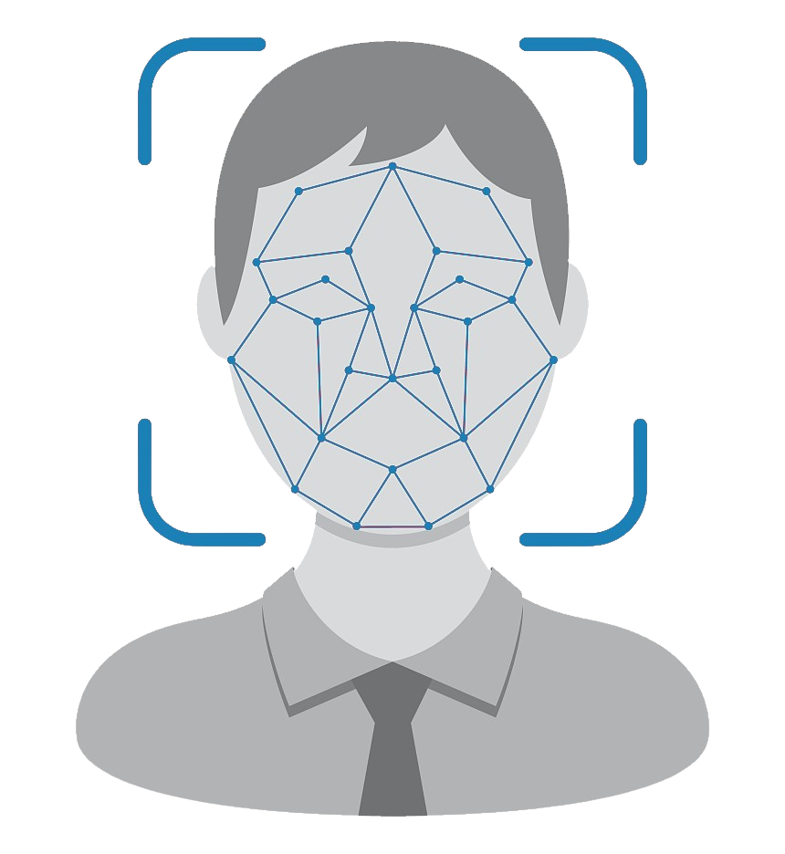
Face attendance system: Face recognition is an Attendance system recognizing the person by using face biostatistics is aimed to accomplish digitization of the traditional system of taking attendance, Present strategies for taking attendance are tedious and time-consuming. The traditional process of making attendance and present biometric systems are vulnerable to proxies.
EVOLUTION OF ATTENDANCE SYSTEMS:

Slide 12
Fingerprint recognition | Facial recognition
Intrusive, subject is require to touch the equipment in order to present a biometric sample. | Non-Intrusive, subject is not require to contact the equipment for presenting the biometric sample.
User consent is required. | User consent may not be required.
Extensively used in identification and authentication. | Extensively used in surveillance and public applications.
High distinctiveness and unique characteristics. Fingerprints do not repeat, not even in twins. | Low distinctiveness. Facial characteristics may repeat in people, e.g. in twins.
Highly accurate | Low accuracy
Subjects cannot be identified from a distance. | Subjects can be identified from a distance.
High permanence and stability, very less affected by age. | Medium permanence and stability, may get affected by age.
Medium collectability. Low exposure due to location of minute details. | Highly collectable. Highly exposed due to location of face and larger details.
Requires specific set of hardware and software. | Can be completely software based, can make use of existing digital images.
Medium universality: Fingerprint may not be available in some individuals. | High universality: Facial features are found in all human beings.
Low potential for circumvention. Not easily spoofable. | High potential for circumvention.
Medium level of acceptability. | High level of acceptability.
Comparson
Between
Fingerprint
And
Face recognition:

Slide 13
Why we use Face recognition system?
ENVIRONMENTAL
LESS DELAY TIME
Under extreme cold or extreme heat, the error rate is also very height in biometric attendance system.
Coronavirus spreads from human touch. If an employee touch the biometric attendance system with coronavirus The virus will spread in the organization
Biometric attendances devices take more time to mark the attendance and causes a long queue of workers in the morning and in the evening.
REDUCE
INFECTION

Slide 14

OUR PROJECT

Slide 15
Main technologies used in the project
Temprature detection
Flutter development
Face recognition

Slide 16
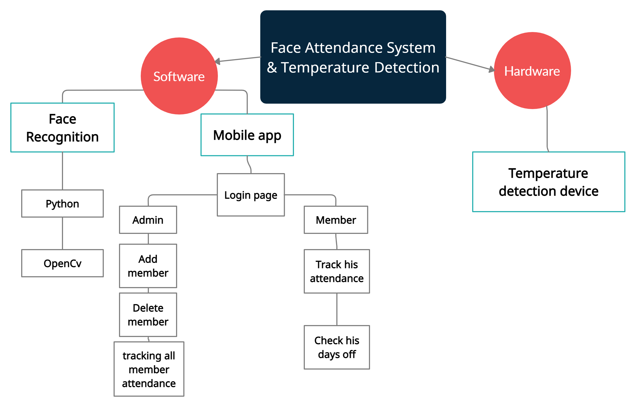
Project structure

Slide 17
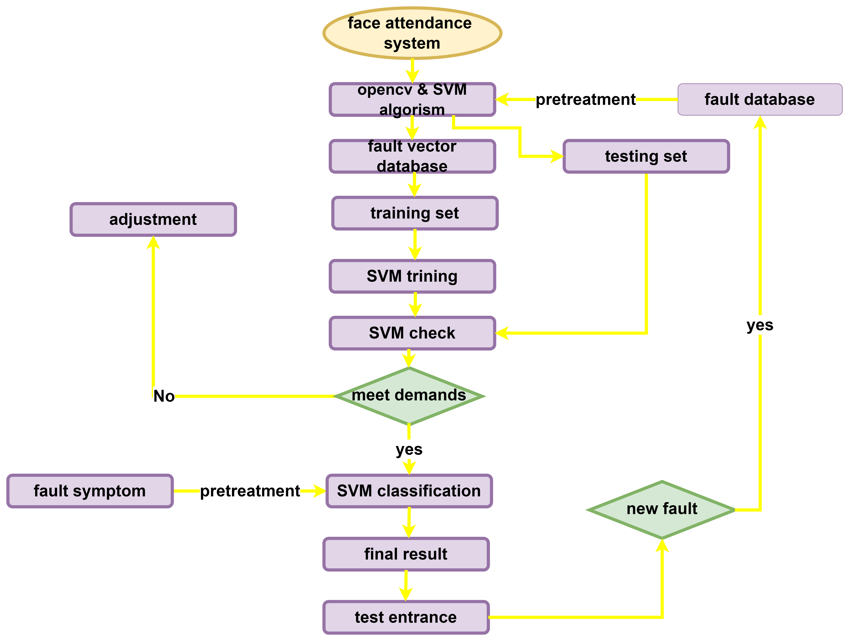
Flow chart

Slide 18
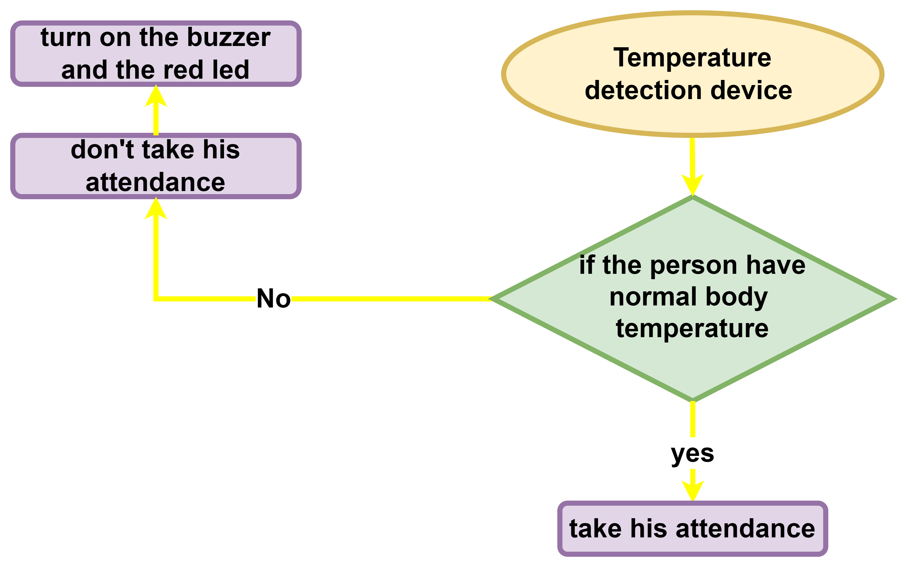
Flow chart

Slide 19
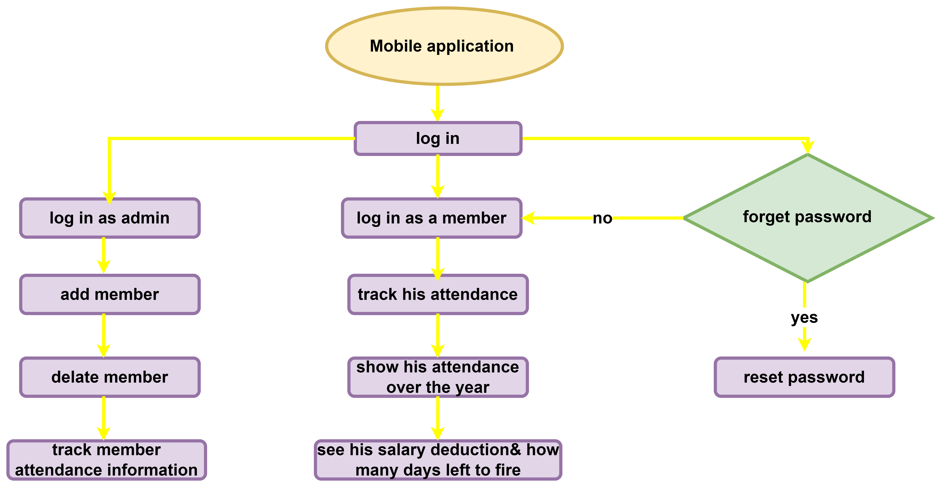
Flow chart

Slide 20
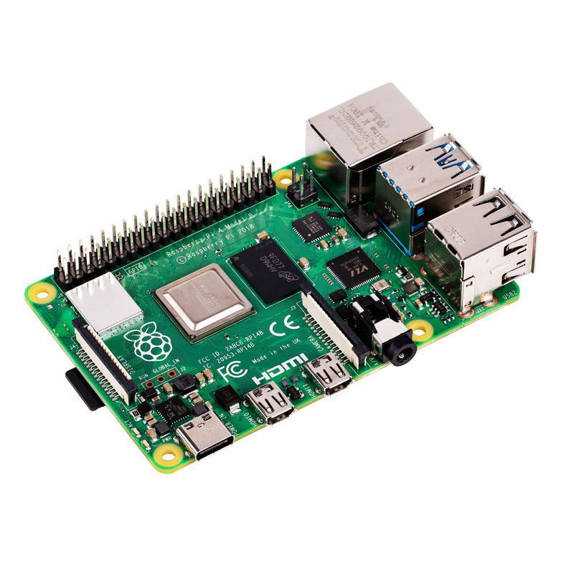
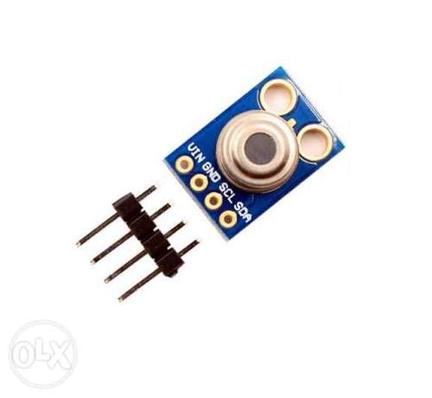
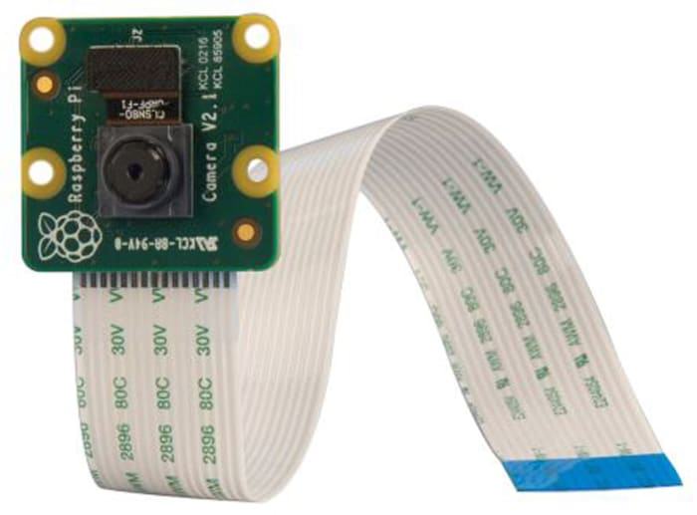
Temperature detection device
We have 3 major component in this part of our project:
1- Raspberry pi 4 : the main bored in this project that
will control and connect the other component
2- MLX90614: it is temperature sensor that will detect
if the member temperature is normal or not
3-Camera module for raspberry pi: it will
take a photo and work as a live camera to take
the attendance for everyone

Slide 21
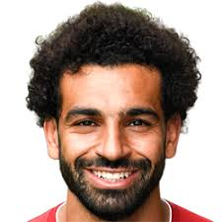
Face Recognition Experiment
This is an Experiment of how Face recognition system works:
Step 1:
we take a training photo of Mohammed Salah as a reference to be uploaded and stored on the system .

Slide 22
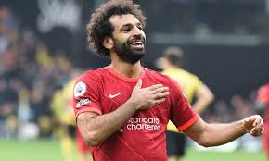
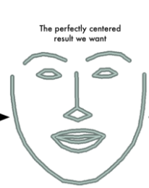
Step 2: Tilted To Frontal Image
The frontal and tilted images of the same person are completely different for the network
Therefore, we use dilp library to find the facial landmarks and warps it so the system can understand it.

Slide 23
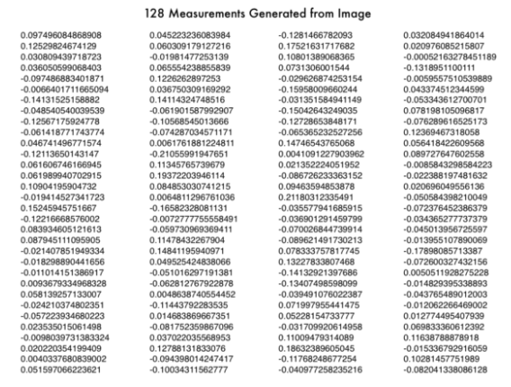
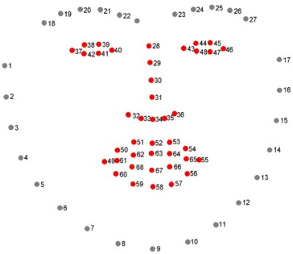
Step 3: Encoding Features with HOG
The Histogram of Oriented Gradients or in short HOG create a simplified version of the image.
The HOG measures the features of the face by generating 128 points of the face.
The 128 measurement points is used define a person and differentiate between different people as well.( but how?)

Slide 24
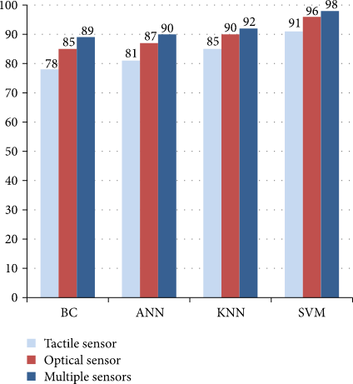
Step 4 : choosing a Machine learning method
KNN
SVM
DC
ANN

Slide 25
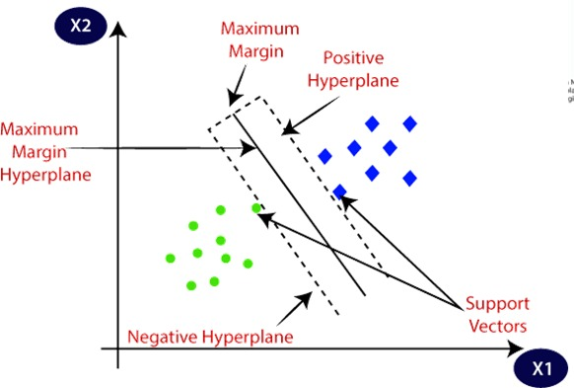
Step 4: The SVM
The SVM is the Support Vector Machine .
SVM is one of the most popular Supervise algorithms, which is used for Classification.
The goal of the SVM algorithm is to choose the extreme points/vectors that help in creating the hyperplane.

Slide 26
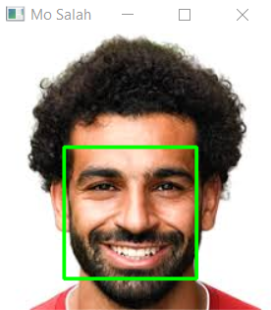
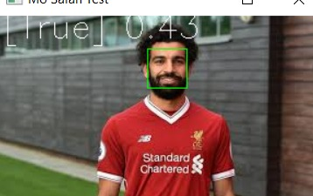
Step 4: SVM
Running this classifier takes milliseconds to find result , differentiate and find the matches between the two photos.

Slide 27
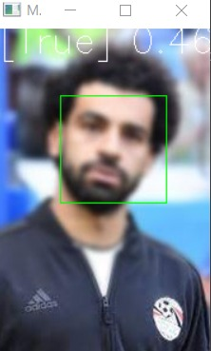
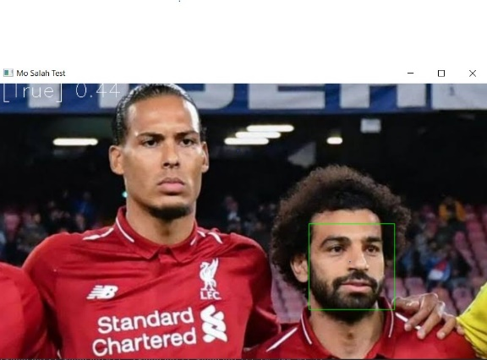
Face Recognition Experiment
Blurry Image:
Here we used another test photo of Mohamed Salah but blurry or pixeled and the result came as true .
Different faces in one Image:
We put another photo with another player and the system detected Mo Salah’s face and can recognized him successfully .

Slide 28
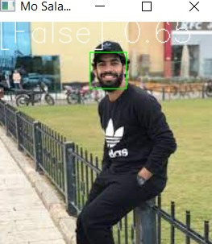
Face Recognition Experiment
Close features:
last, we added a photo of Nasr Salah who is
Salah’s brother as the have very close face features and the result came as false.
Now let’s Move to another point.

Slide 29
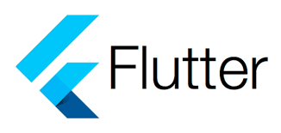
Mobile Applications
We choose flutter to programming our application:
What is Flutter?
Flutter is a free and open-source mobile UI framework created by Google and released in May 2017.
In a few words, it allows you to create a native mobile application with only one codebase.
This means that you can use one programming language and one codebase to create two different apps (for iOS and Android).

Slide 30

Mobile Applications
Flutter consists of two important parts :
1- An SDK (Software Development Kit): A collection of tools that are going to help you develop your applications. This includes tools to compile your code into native machine code (code for iOS and Android).

Slide 31

Mobile Applications
2- A Framework (UI Library based on widgets): A collection of reusable UI elements (buttons, text inputs, sliders, and so on) that you can personalize for your own needs .

Slide 32

Mobile Applications
To develop with Flutter, you will use a programming language called Dart. The language was created by Google in October 2011, but it has improved a lot over these past years . Dart focuses on front-end development, and you can use it to create mobile and web applications.

Slide 33
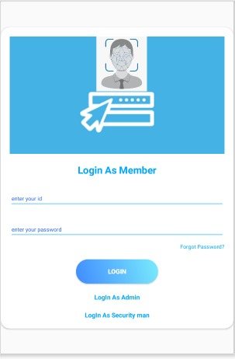
Project Mobile Applications
We choose this logo till now it refer to
our major technic we use in this project
which is Face Recognition
Main page (login page) : this is our home page you as a
member can login by it and there is an option to choose to
login as admin.
And it contain also an option for who forget his password

Slide 34
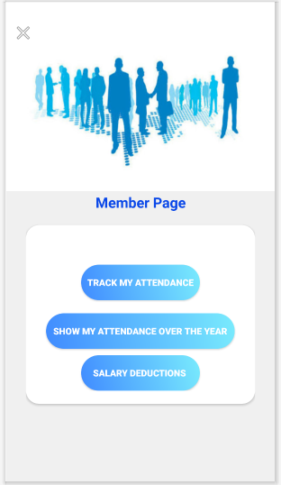
Project Mobile Applications
Member Page: it is contained what member can do in this app which is 3 things
- track his attendance in this month
- Track his attendance over the year to know his
holidays Left in his year
- show if he has salary deductions because
He came late for example

Slide 35
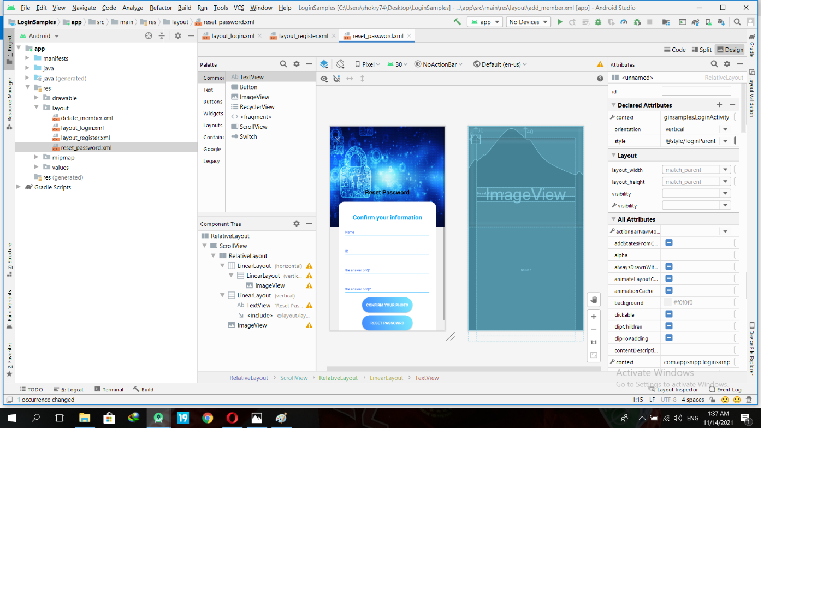
Project Mobile Applications
Reset password page:
It make sure you the one who forget the password not some one else try to login from your account by asking you about some information you enter in the app

Slide 36
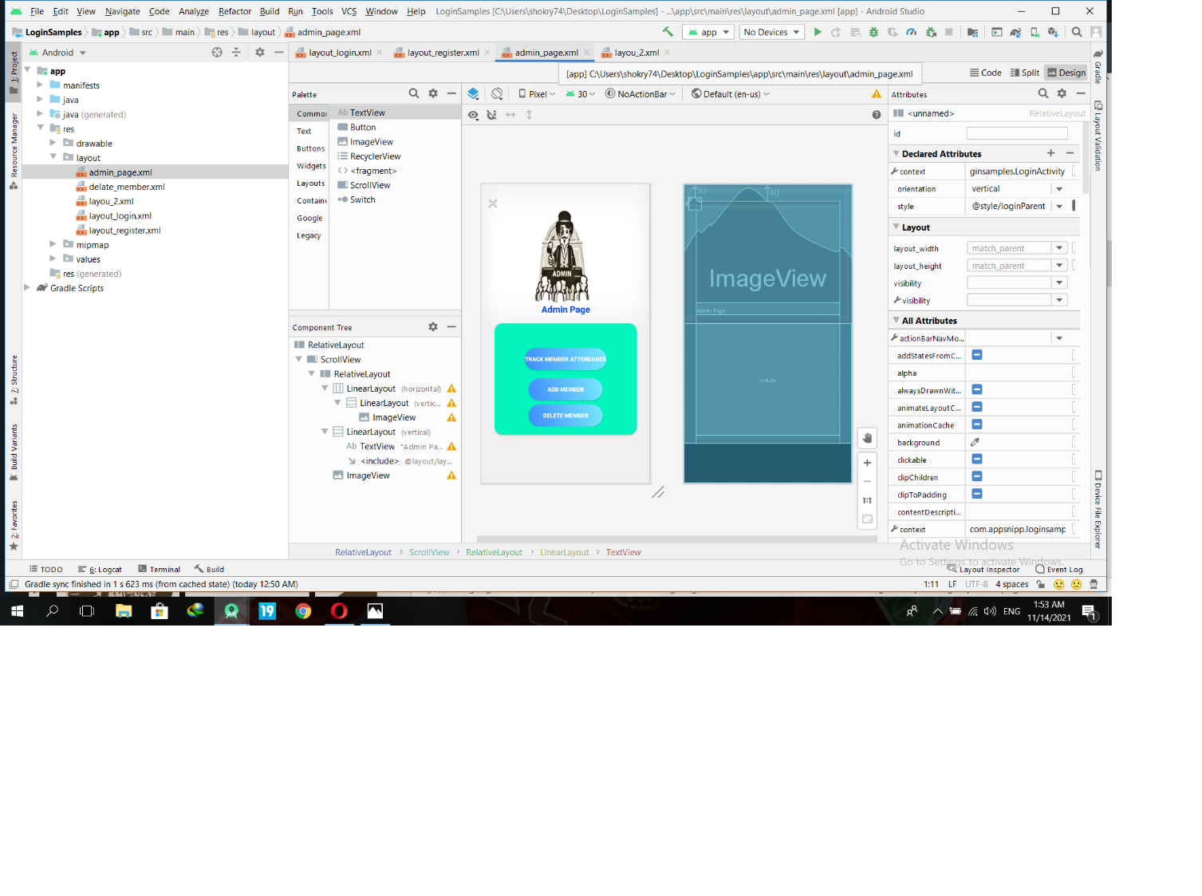
Project Mobile Applications
admin page: and from this page admin can add member,
delete member and track all member attendance.

Slide 37
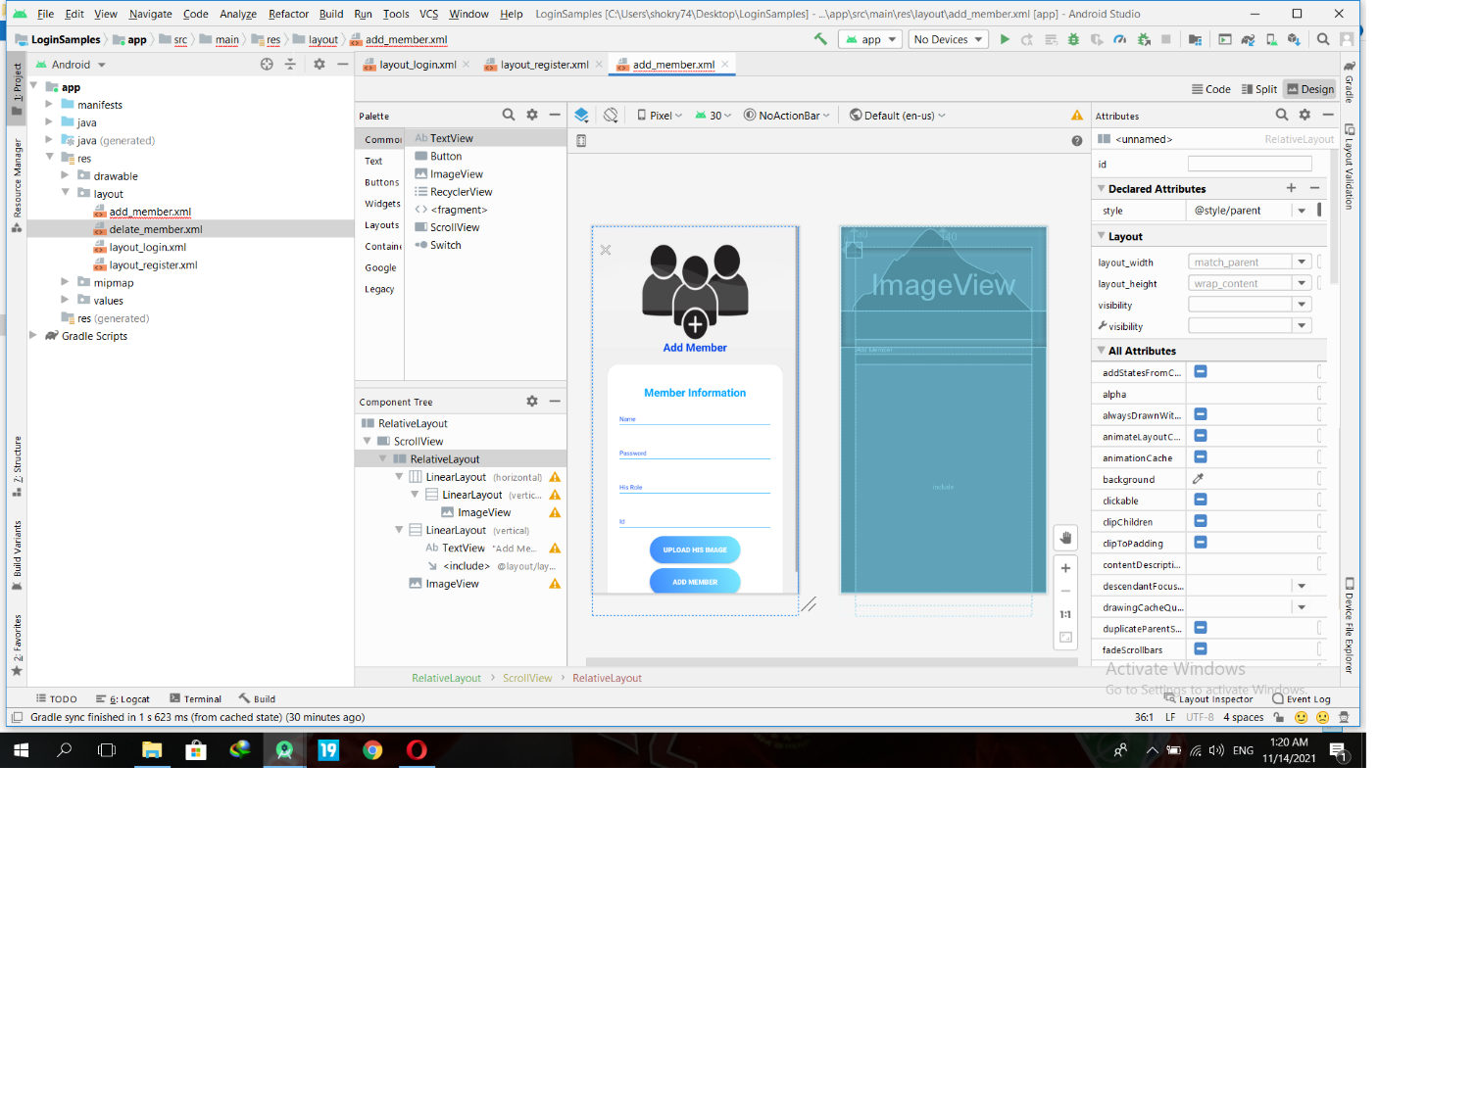
Project Mobile Applications
Add member page: It contain the required information to add the member his name his role his password and last admin
must upload his photo.

Slide 38
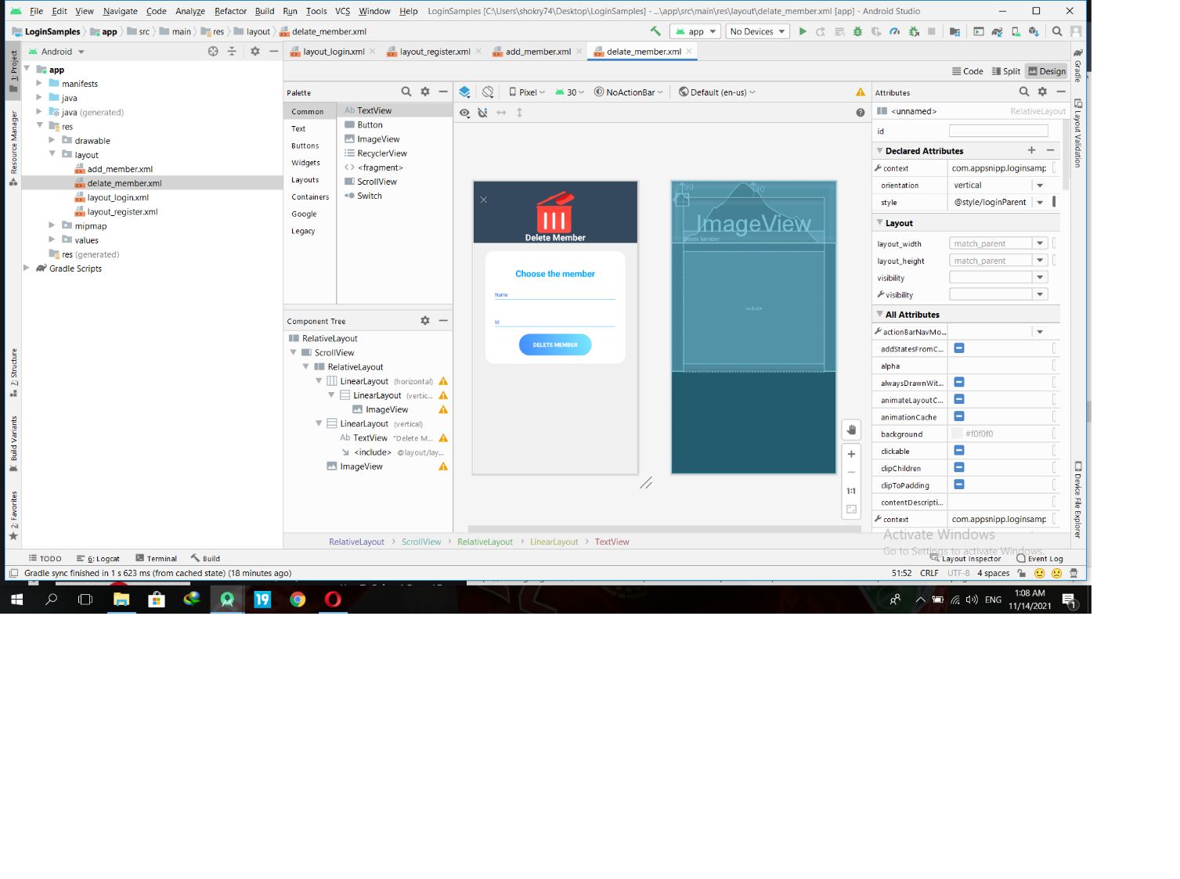
Project Mobile Applications
Delete member page: and it contain the required information that the admin must enter to be allow to delete a member.

Slide 39
OUR TEAM
Abdullah Gamil
Omar Gamal Saad
Abdulrahman Mahmoud
Abdullah Sayed

Slide 40
THANKS!
Assoc. Prof. : Ahmed El-Mahalawy
Eng. : Baraa Ahmed

